Slide 1
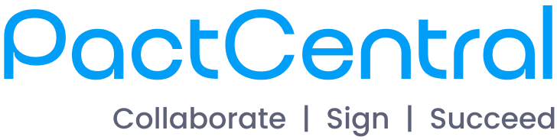
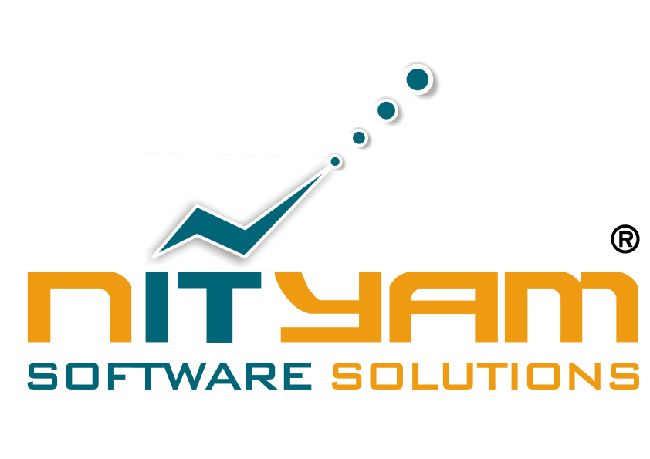
Effortless Contracting. Unlimited Possibilities
Presented By :-

Slide 2
The Business Problem
Contracts shouldn’t slow business growth - but they do.
Fragmented Workflows - Contracts spread across emails, drives, and No central visibility or collaboration.
Manual Effort - Delays in drafting, Repetitive tasks and delays.
Delayed Turnaround - Bottlenecks in approvals & Signatures.
Risk Exposure - No version tracking, inconsistent clauses, poor auditability.
Lack of Visibility - No real-time status tracking.
Regulatory & Compliance Risks - No audit trail.

Slide 3
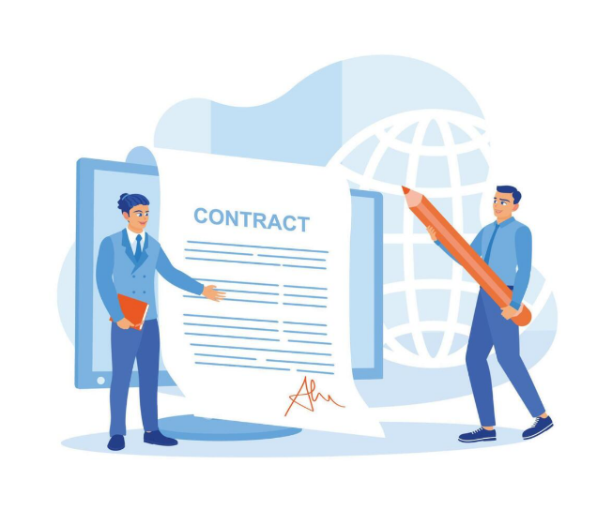
Introducing PactCentral
PactCentral is a smart, secure, and efficient platform to manage the complete life cycle of legal agreements from raising a request to signing a contract, archiving with validating QR code with a robust document search engine.

Slide 4

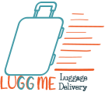


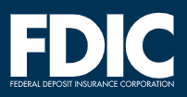


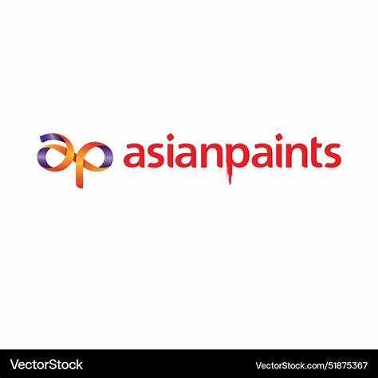


Successfully Implemented at Glenmark Pharmaceuticals - 80,000+ Contracts Executed Globally in Just 2 Years.
PactCentral’s secure CLM platform powers Glenmark’s global contracting transformation
— driving efficiency, compliance, and scale
With PactCentral
Without PactCentral
Centralized Repository
Unified Workflows
Scattered Contracts
Real-time Dashboard
Lengthy Approval TAT
Online Contract Drafting
Missed Renewals
Digital Signing
Disjointed Legal
Communication
Audit Trails

Slide 5






Simple Process
Easy To Use Process
Initiate Request #1
Add Reviewers #2
Review & Approve #3
The process begins with a
request for legal agreements.
Internal & external reviewers are added to the process.
The document is reviewed and approved by the reviewers.
Generate QR code #4
Print & Sign #5
Publish Document #6
A QR code is generated on each page of the document.
The document is printed and signed digitally or physically.
The signed document is published for distribution.

Slide 6

Smart Drafting - From Hours to Minutes.
Select Template
I used to spend hours finding old clauses - now I draft in minutes using templates.
Access Clause Library
Draft Contract
Initiator / Contract Creator
Submit for Review & Approval

Slide 7
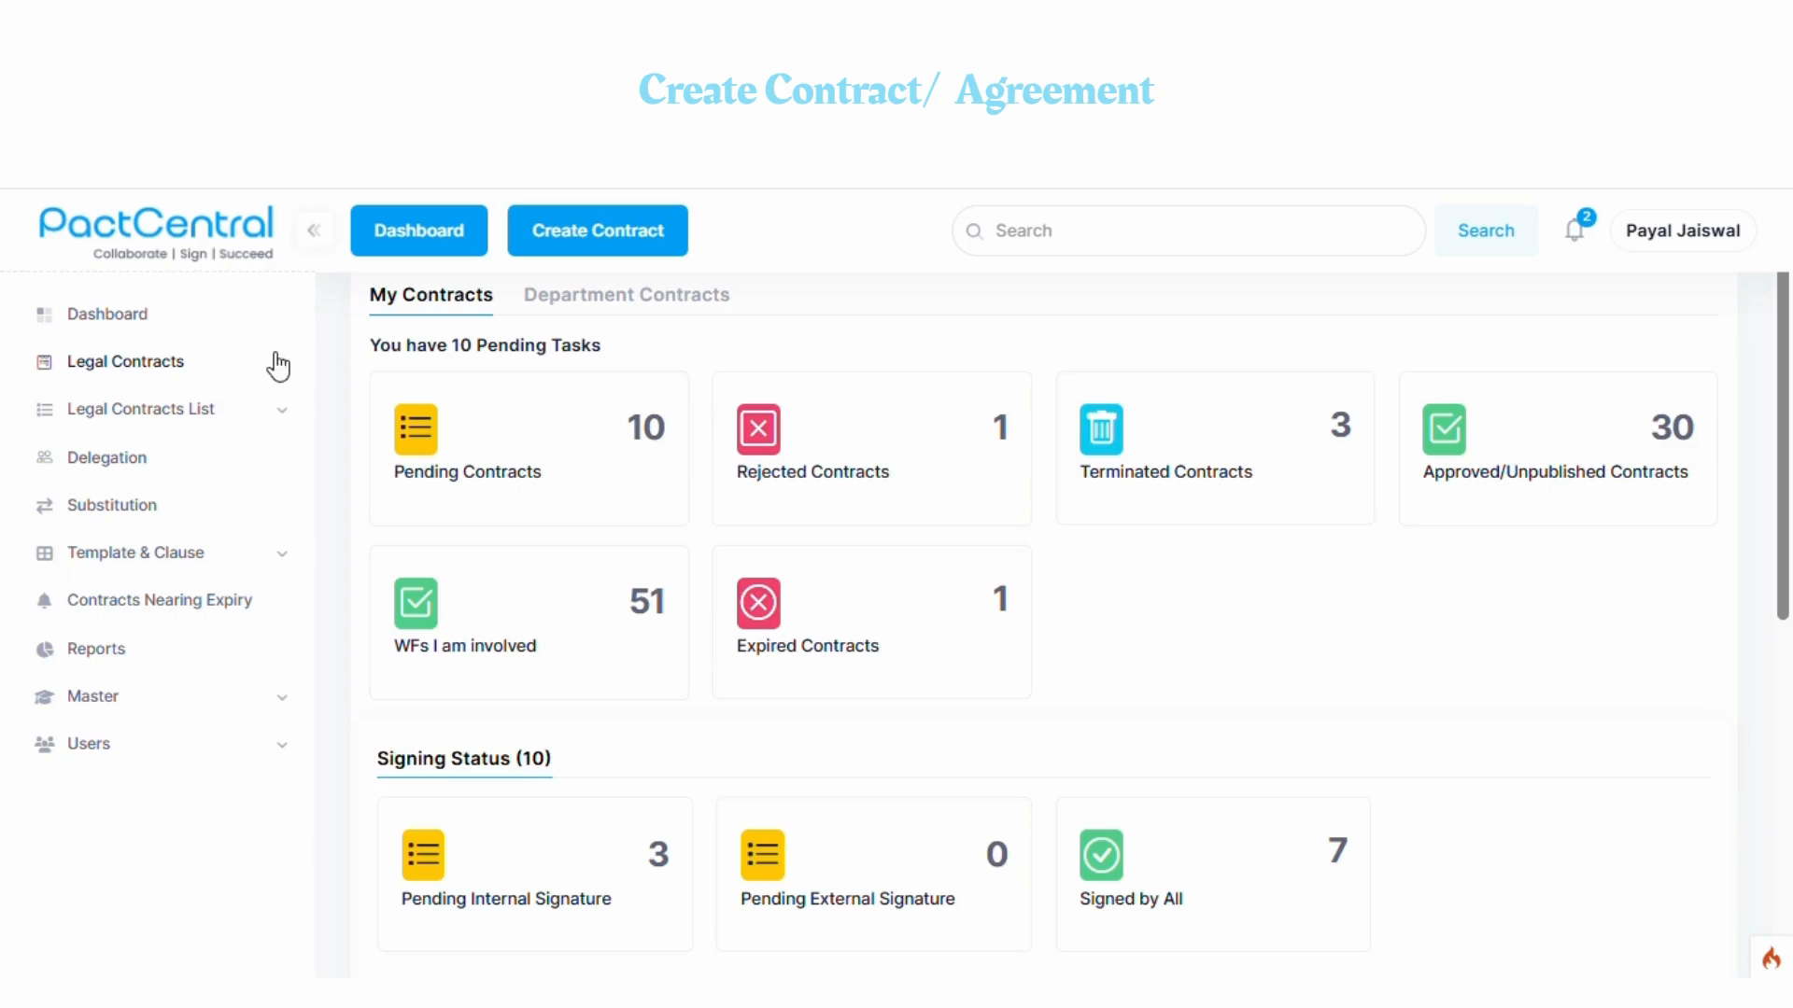
Initiator / Contract Creator
Journey to create contract

Slide 8

Streamlined Approvals - Fast, Secure, and Traceable.
Receive Notification
No more email delays - get instant notifications, review contracts online, and approve securely
Review Online
Reviewer / Approver
Approve Securely

Slide 9
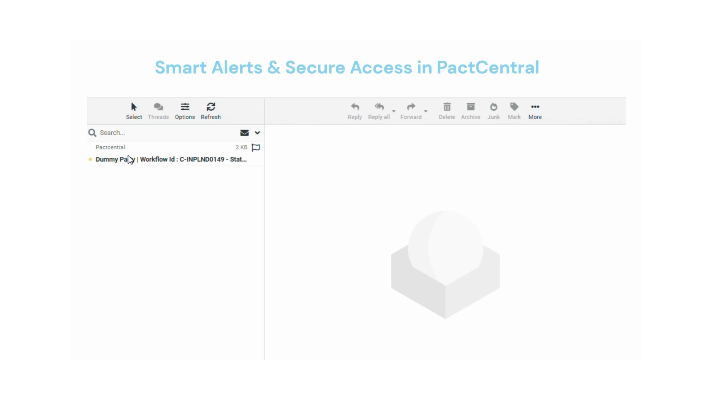
Review, edit, and approve online

Slide 10

eSigning Made Effortless - Secure, Compliant, and Auditable
Signer Identity Authorization
One click e-sign - Fully Compliant & Auditable
One Click Signing
Multi-Party Signing
Signer (CXO / Director)
Timestamp Verification
Global eSign Integration

Slide 11
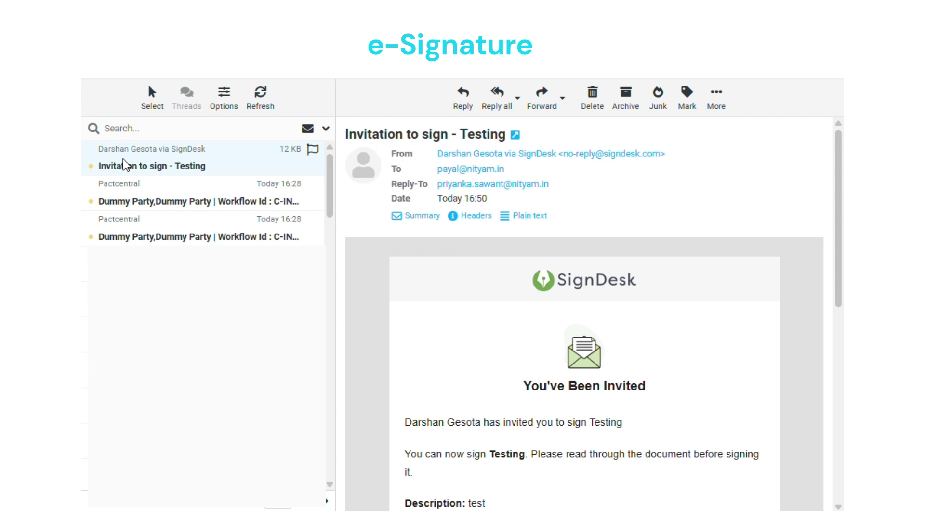
E-Signing

Slide 12

Total Visibility. Smarter Decisions.
Compliance / Admin
Finally we have visibility - every contract, every status, one dashboard.
Audit Trails
Renewal Alerts
Compliance / Admin
Analytics Dashboard

Slide 13
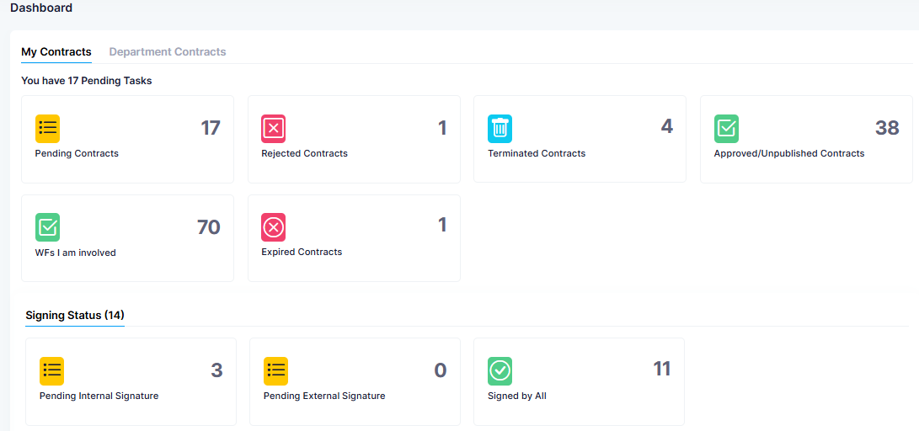
Dashboard
A real-time dashboard that displays what's pending, approved, or
needs your attention - tailored to each user based on their data access controls.

Slide 14
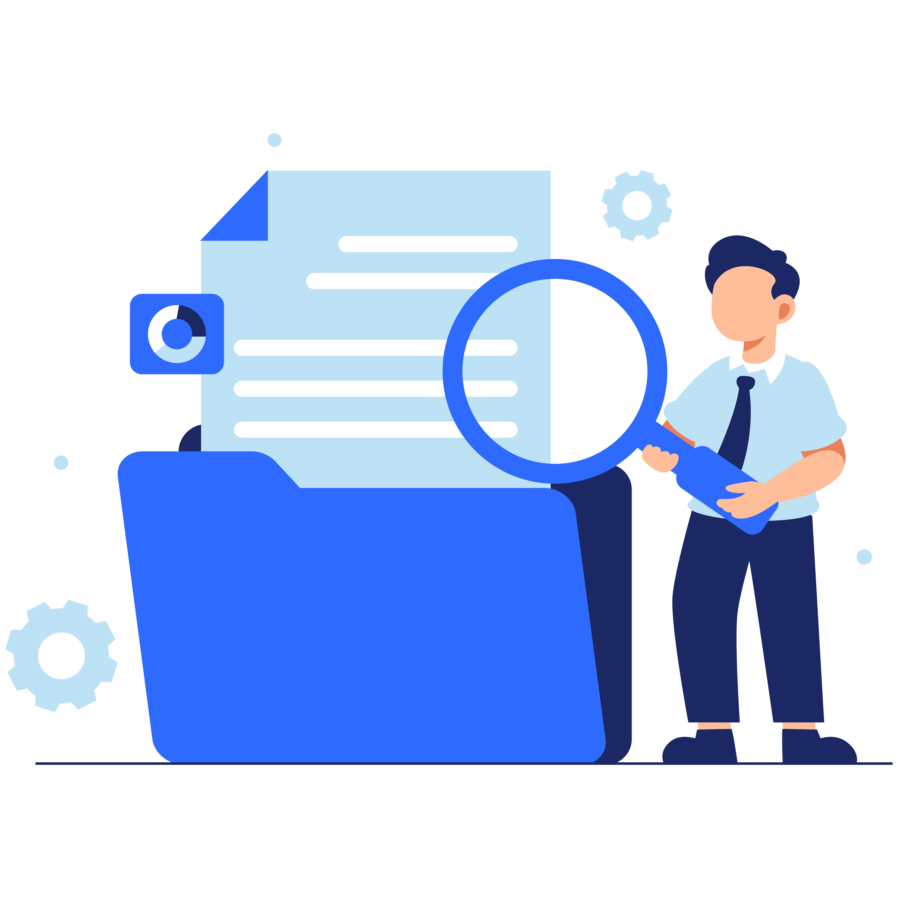
Advanced Document & Meta Search
Keyword Search
Clauses
Allow users to find documents using specific words or phrases.
Identifies documents containing specific contractual clauses
Metadata Search
Users
Enables searching based on document attributes like country & agreement type
Filters documents based on the users involved
Country
Party
Filters documents by the country of origin or relevance
Searches for documents related to specific parties or organizations
Agreement Type
Entities
Categorizes document by the type of agreement they represent
Identifies document associated with particular entities or subjects

Slide 15
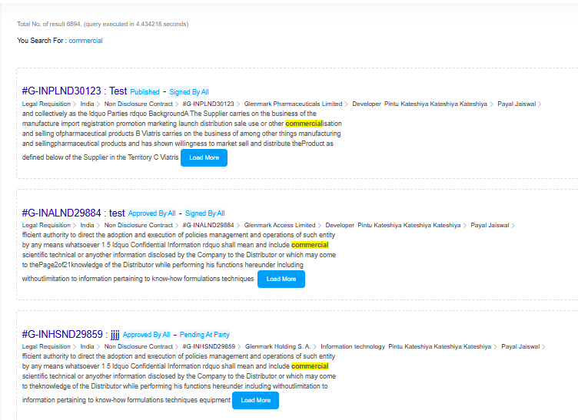
Advanced Document & Meta Search

Slide 16
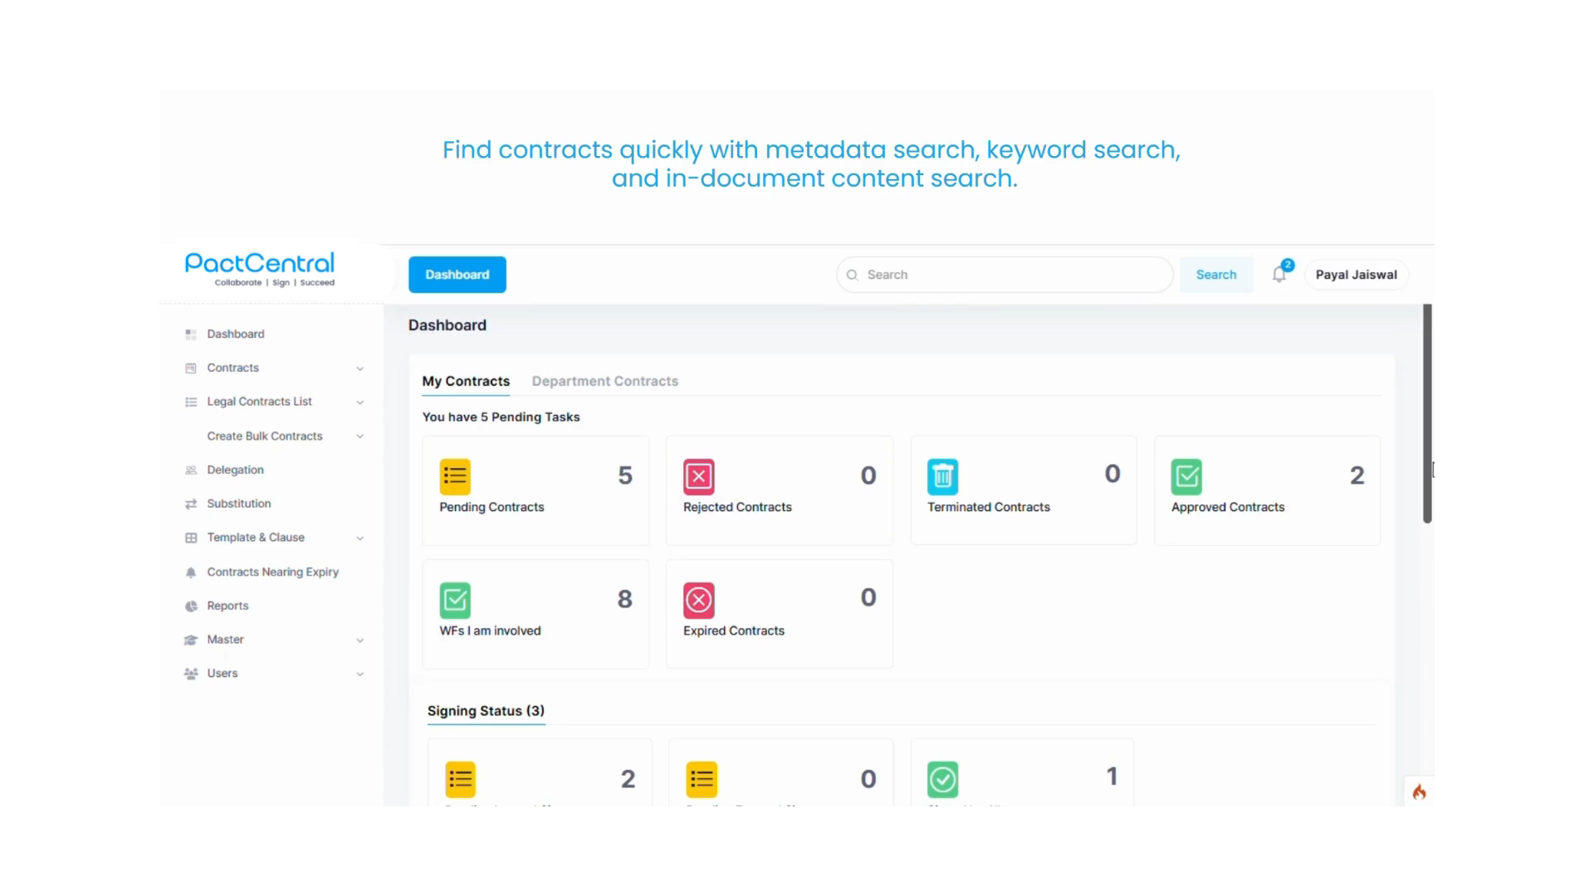
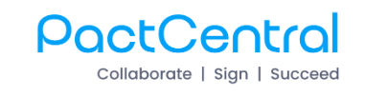
Advanced Document & Meta Search

Slide 17
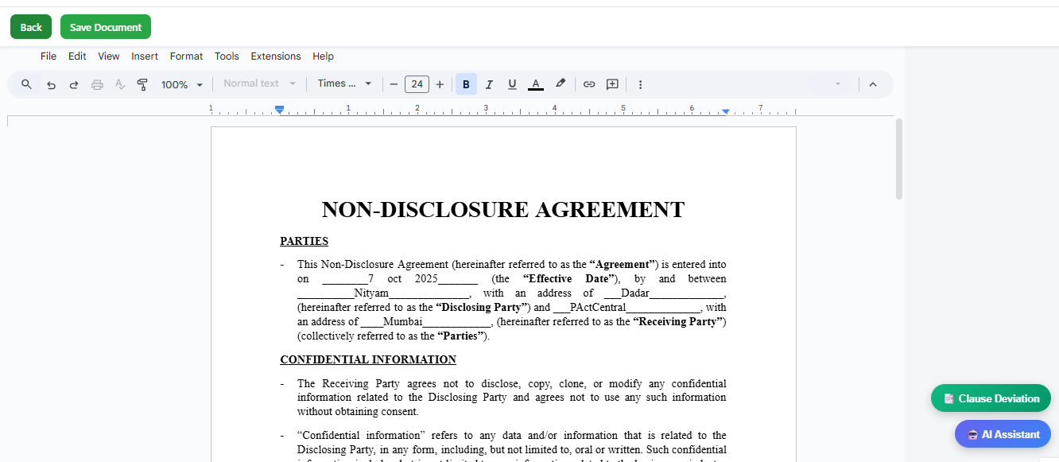
Document Editing
Seamless online document editing, commenting via API integration with Google docs.

Slide 18
No external data transmission
Private LLM Engine
Secure, Intelligent, and Enterprise-Ready
All AI processing remains on-premises.
Integrated with internal security protocols
(ADFS, 2FA, role-based access)
Trained LLM
PactCentral integrates a Large Language Model (LLM) engine to deliver AI-powered insights –
from smart drafting to risk detection –
all hosted within your intranet environment to ensure complete data security and privacy.
Trained on your organization’s own contract templates, not public data.
Full audit trails and AI activity logs
For transparency and compliance.

Slide 19
Clause Analysis
Contract Risk Analysis
Identify, Quantify & Control Contractual Risks
AI reviews each clause (like indemnity, confidentiality, termination) and compares it to your approved templates.
Risk Detection
Missing, weak or non-standard clauses are flagged and given risk points.
Weighted Scoring
PactCentral automatically evaluates each contract
for potential legal, financial and compliance risks - giving you a clear, data-driven Risk Score for
smarter decision-making.
Each risk category (Legal, Compliance, Financial, etc.) is scored and weighted by importance.
Overall Risk Score
System calculates a 0-100 score and classifies the contract as:
High Risk (0 - 40) :- Needs Legal Review.
Medium Risk (41 - 70) :- Review Recommended.
Low Risk (71 - 100) :- Auto Approved.

Slide 20
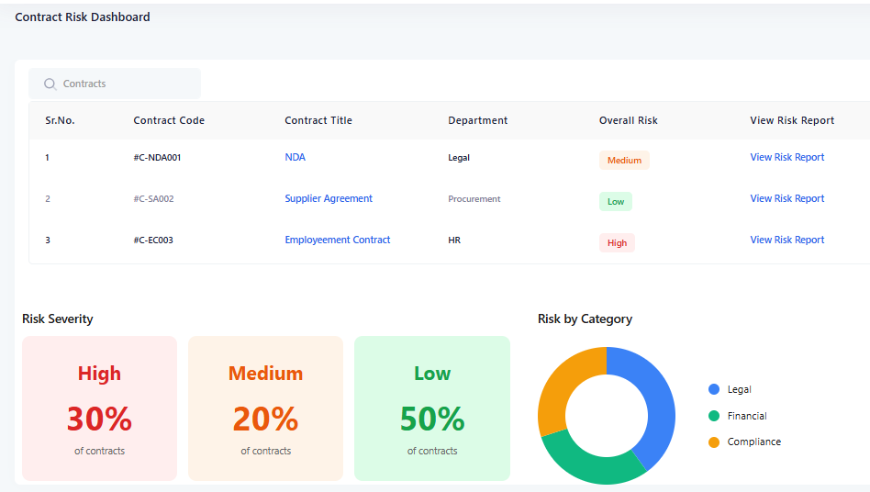
Contract Risk Dashboard
PactCentral helps you detect risk before approval, reducing legal exposure and compliance issues early in the contract lifecycle.

Slide 21
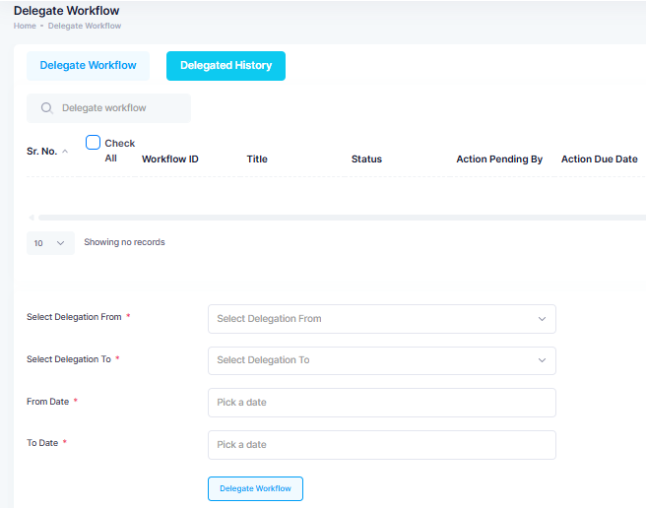
Deligate
This will be temporary for a period.
Example: While workflow approver/reviewer is on leave, they may choose to delegate their requests to their delegations. Once the user is back, all the documents processed by the delegated person has to be accessible to the original user.

Slide 22
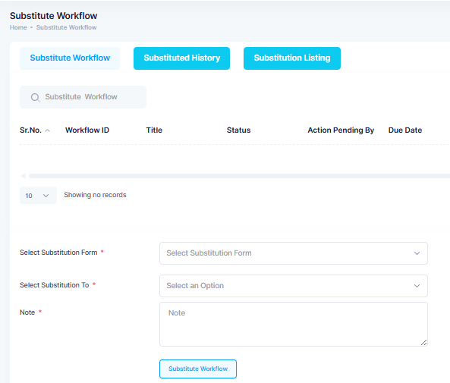
Substitute
When employee is exiting from the organisation then, a provision to transfer his pending/approved requests to other substitutes. Once the user has left, all the documents processed by the separated person has to be accessible by the substituted user.

Slide 23
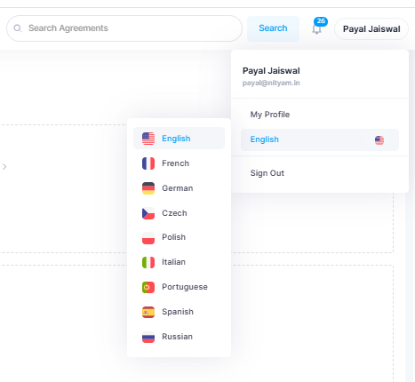
Multilingual Support
Supports multiple languages including English, French, German, Czech, Polish, Italian, Portuguese, Spanish, Dutch, Chinese and Russian for broader accessibility and usability.

Slide 24
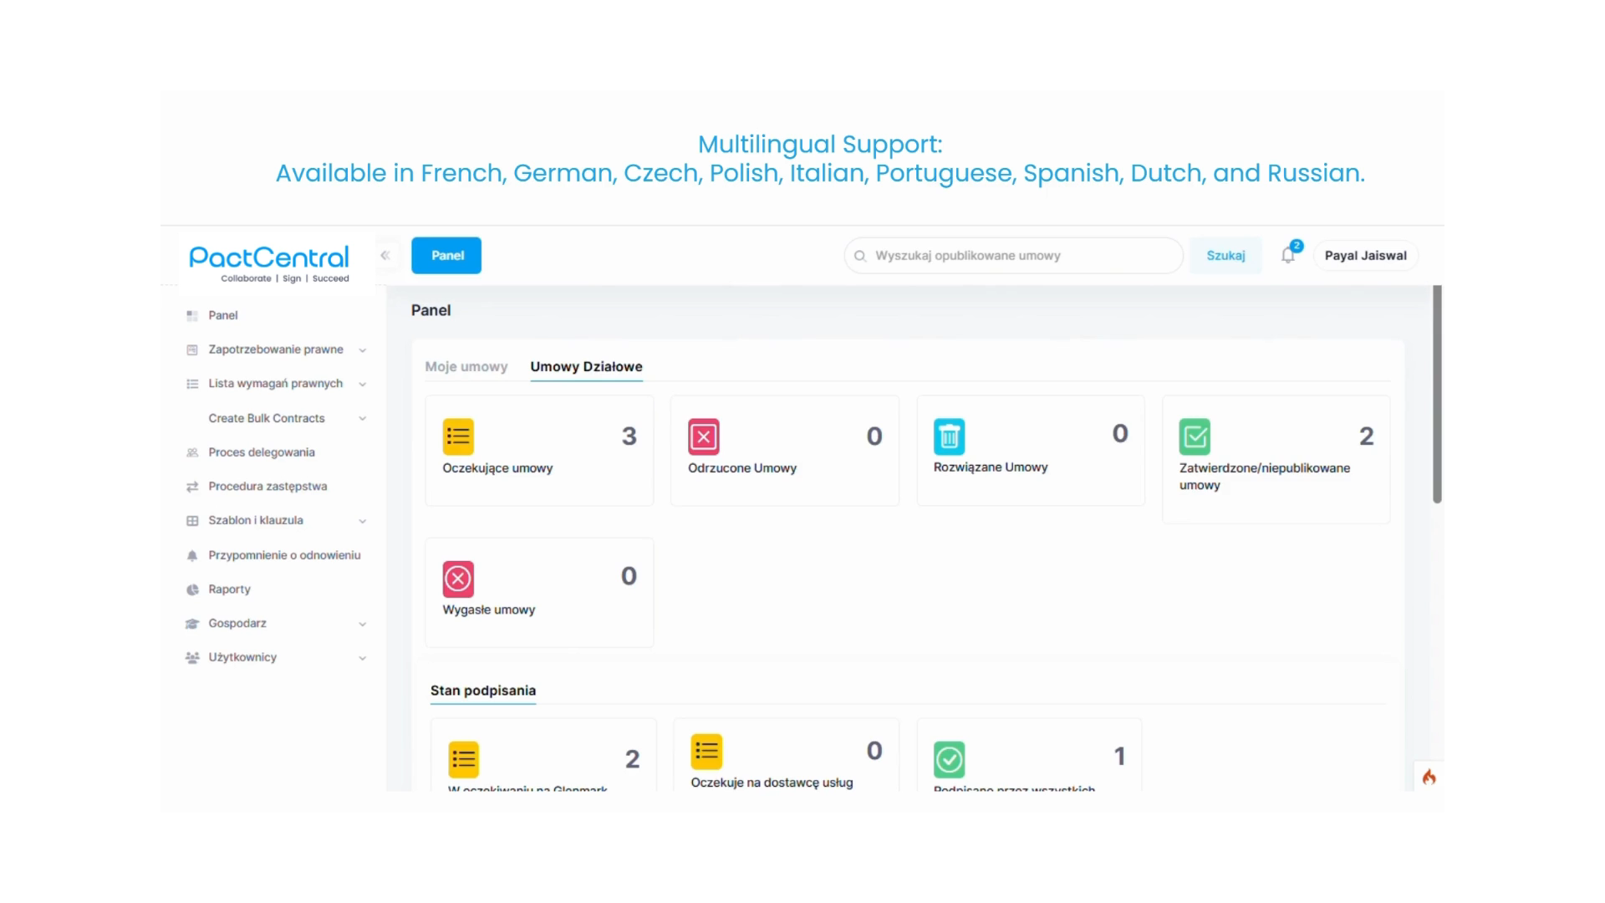
Multilingual Support

Slide 25



Reports
Generate customized reports based on document data, user activity, and metadata filters for actionable insights
User Engagement
Metadata Filters
Tailored Reports
Data on how user interacts with document.
Applying filters to refine data.
Creating specific reports based on filtered data.

Slide 26
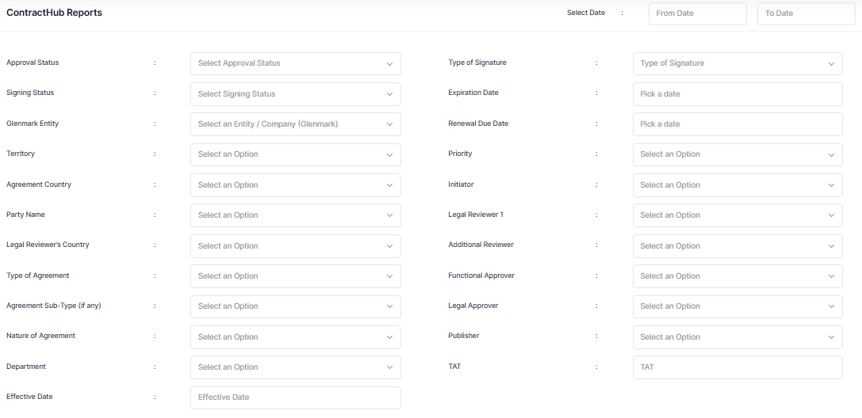
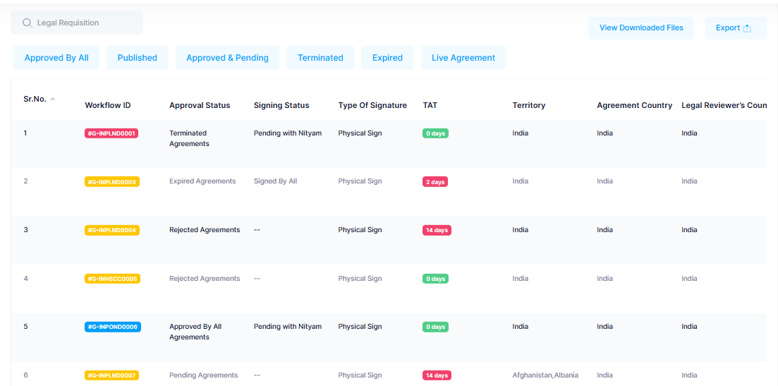
Reports

Slide 27
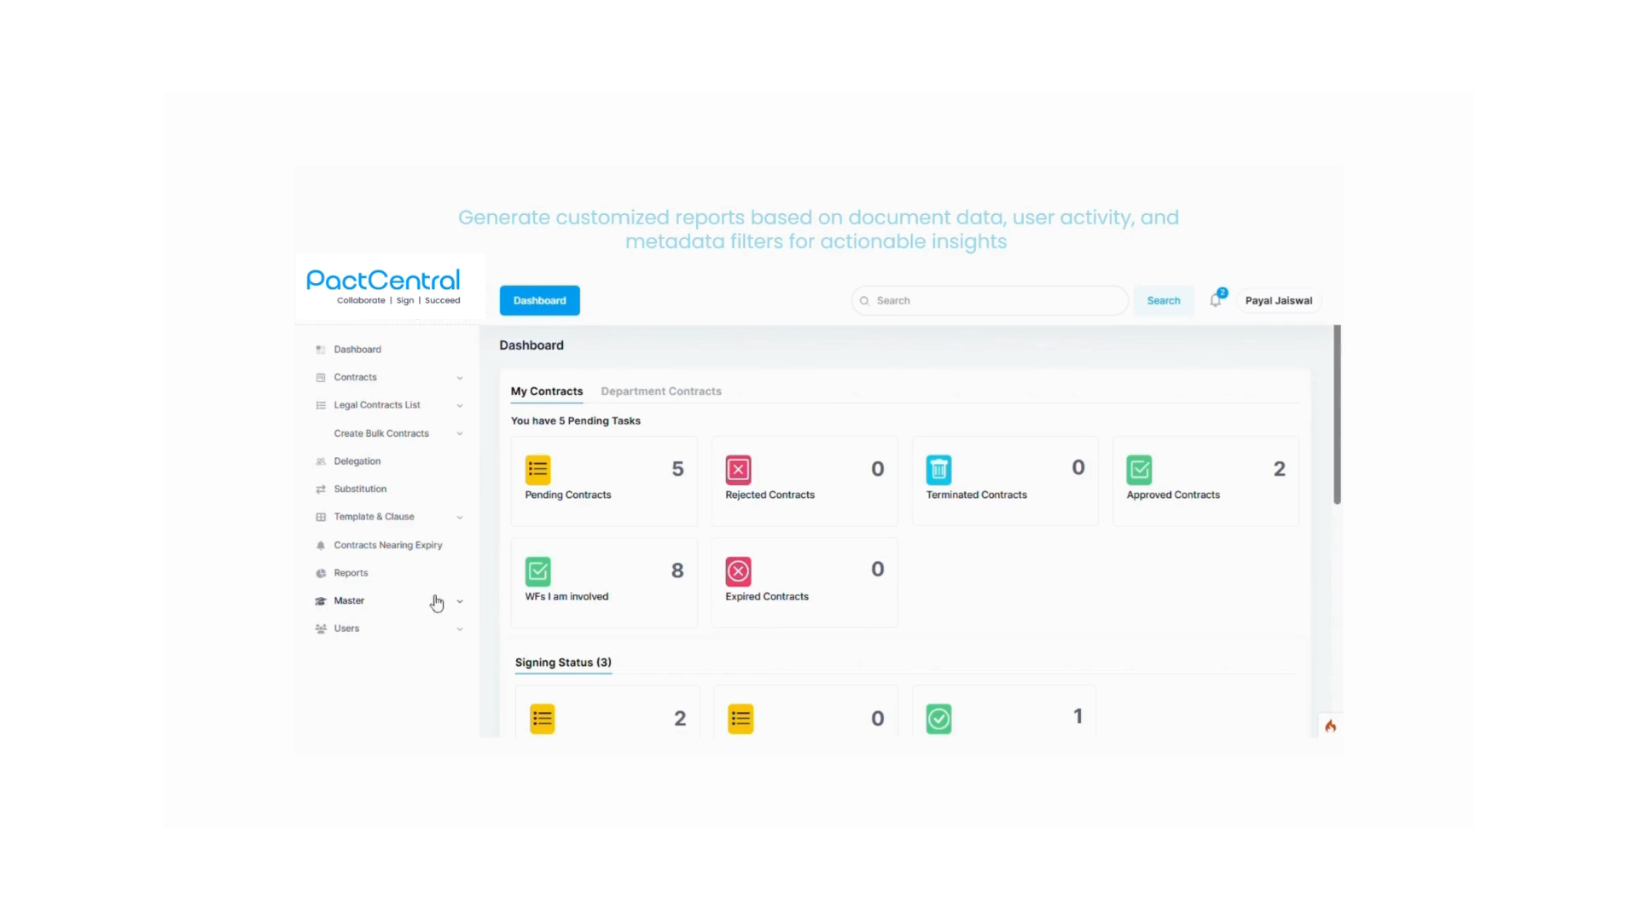
Reports

Slide 28
System Integration
PactCentral fits into your enterprise ecosystem
Microsoft ADFS
CRM/
Vendor Portal
Google Docs/
OnlyOffice
Integration for
Single Sign On
Integration with the
CRM/vendor portal.
e.g Salesforce
Document editing,
highlighting, and
commenting.
Signdesk
HRMS
LLM
E-Signature of final
legal documents.
Employee,
designation,
location, and
department data.
All hosted within your intranet environment to ensure complete data security and privacy..

Slide 29
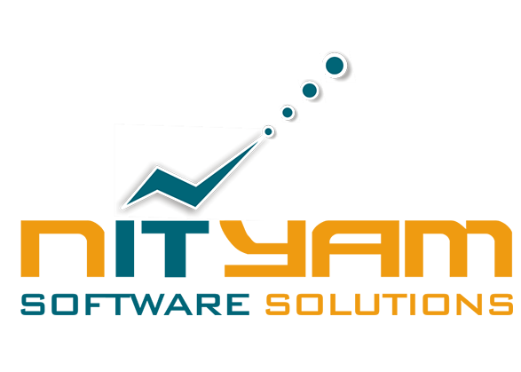



Let’s Simplify Contracting Together
Phone
+65 90147536
Website
India Office
Singapore Office
www.pactcentral.com
Nityam Software Solutions Pvt. Ltd.
C/1, Harganga Mahal, Dadar TT Circle,
Dr. B.A. Road, Dadar, Mumbai-400 014. India.
Nityam Singapore Pte. Ltd.
24 Ean Kiam PI,
Singapore - 429115.
Mail
sales@pactcentral.com
Phone : +91 9372720878
WhatsApp No : +65 90147536

